Slide 1






Cryptocurrency Wallets and Transactions
Types of Crypto Wallets, Cryptocurrency Transactions
Svetlin Nakov
Technical Trainer
Academy School of Blockchain
http://kingsland.academy

Slide 2


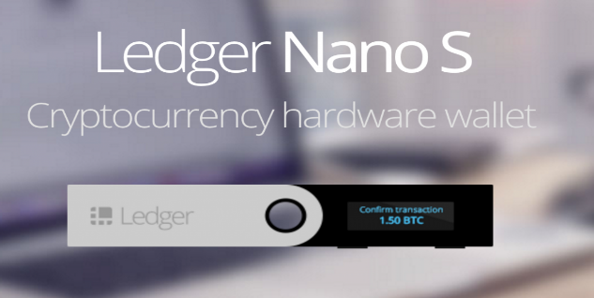
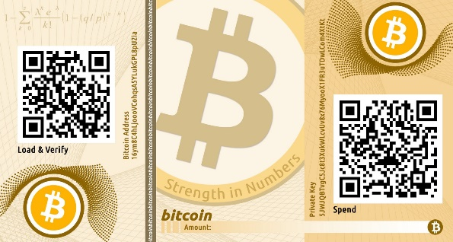


Table of Content
Types of Wallets
Mobile (e.g. Jaxx)
Desktop (e.g. Exodus)
Web-based Wallets
Hardware-Based Wallets
Paper Wallet
Cryptocurrency Wallet Products
Bitcoin Transactions
Creating a Bitcoin Transaction
Transaction Cost

Slide 3

Crypto Wallets
Mobile, Desktop, Hardware, Paper Wallets

Slide 4
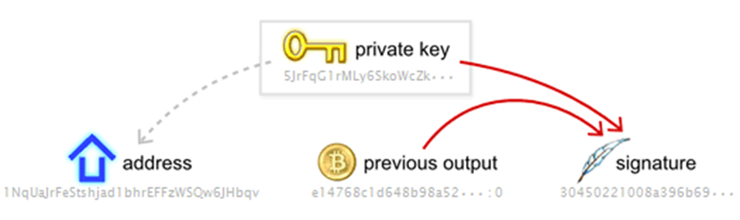
What is a Cryptocurrency Wallet?
Wallet == software that stores private and public keys
Enables users to send and receive digital currency
Communicates with the blockchain network through API
Sign transactions and send them to the blockchain network
If you want to use Bitcoin / Ethereum / other cryptocurrency, you will need a crypto wallet
Notes:
a software program that stores private and public keys and interacts with various blockchains
a program that enables users to send and receive digital currency and monitor their balance
if you want to use Bitcoin or any other cryptocurrency you will need to have a cryptocurrency wallet

Slide 5

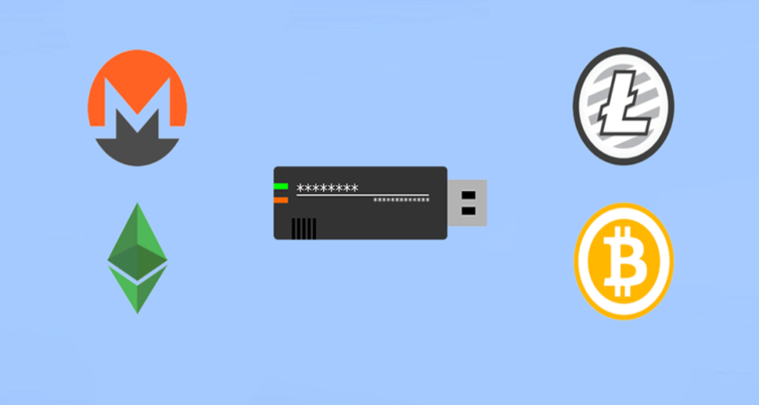
Types of Wallets
Mobile wallet (mobile app)
Desktop wallet (desktop app)
Web-based wallet (web site)
Hardware-based wallet (USB token)
Paper wallet (private key printed on a sheet of paper)

Slide 6
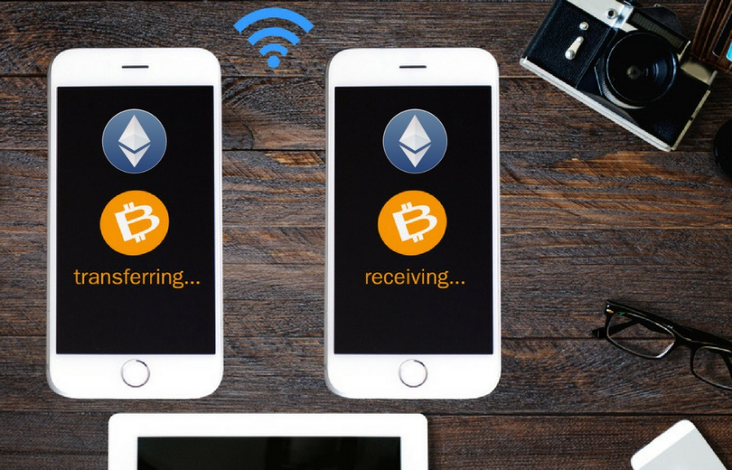

Mobile Wallets
Mobile wallet app
Keeps private keys and can sign / send transactions, view balance
Convenience + risk to access your crypto-assets in the pocket
Wallets do not store actually cryptocurrency
They store your private keys

Slide 7
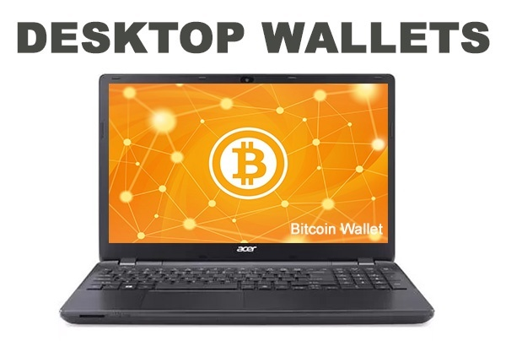

Desktop Wallets
A desktop wallet runs in your laptop (Windows / Linux / Mac OS)
Desktop wallets are regarded as safer than exchange wallets
Remember: desktop wallet is only as secure as your computer!
A desktop wallet gives you full control of your private keys
Notes:
a desktop wallet is only as secure as your computer
if security practices are followed desktop wallets are regarded as safer than exchange wallets
a desktop wallet is often baked into a blockchain client
having a desktop wallet means you are in full control of your private keys

Slide 8
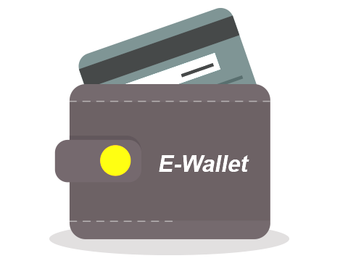
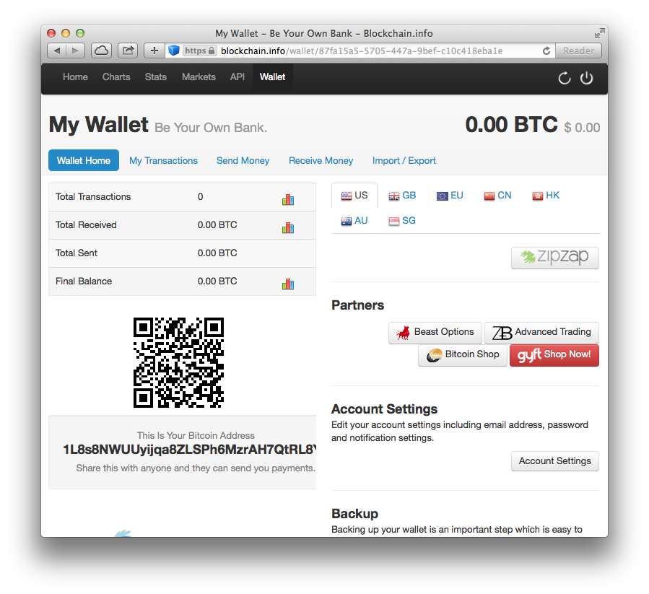
Web-Based Wallets
No application download
Access the wallet from the web
Security is controversial
Your private key stays at the server!
Typically uses a two-factor authentication (e.g. pass + SMS)
Some online wallets are hybrid wallets (app to sign transactions)
Notes:
An online wallet is literally a web-based wallet. You don’t download an app, but rather data is hosted on a real or virtual server. Some online wallets are hybrid wallets allowing encryption of private data before being sent to the online server

Slide 9

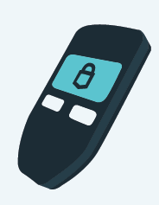
Hardware-Based Wallets
Hardware wallet
Hardware device built to hold cryptocurrency and private keys
E.g. USB token
Strong security
Your private keys stay in the device, not in your computer
Each transaction is signed by a button click on the device
Hacked computer does not compromise the wallet
Notes:
Hardware Wallet: Dedicated hardware that is specifically built to hold cryptocurrency and keep it secure. This includes USB devices. These devices can go online to make transactions and get data and then can be taken offline for transportation and security

Slide 10

Paper Wallets
Paper wallets hold public + private keys printed on a paper
May contain a QR code to allow scanning the keys
Security
Can be copied by a camera
May hold the keys encrypted
Paper and ink are fragile
Keys are not stored digitally
Notes:
It contains public and private keys tha
Often paper wallets have QR codes
keys are not stored digitally anywhere and can not be a subject to cyber attacks
disadvantage is that paper and ink

Slide 11
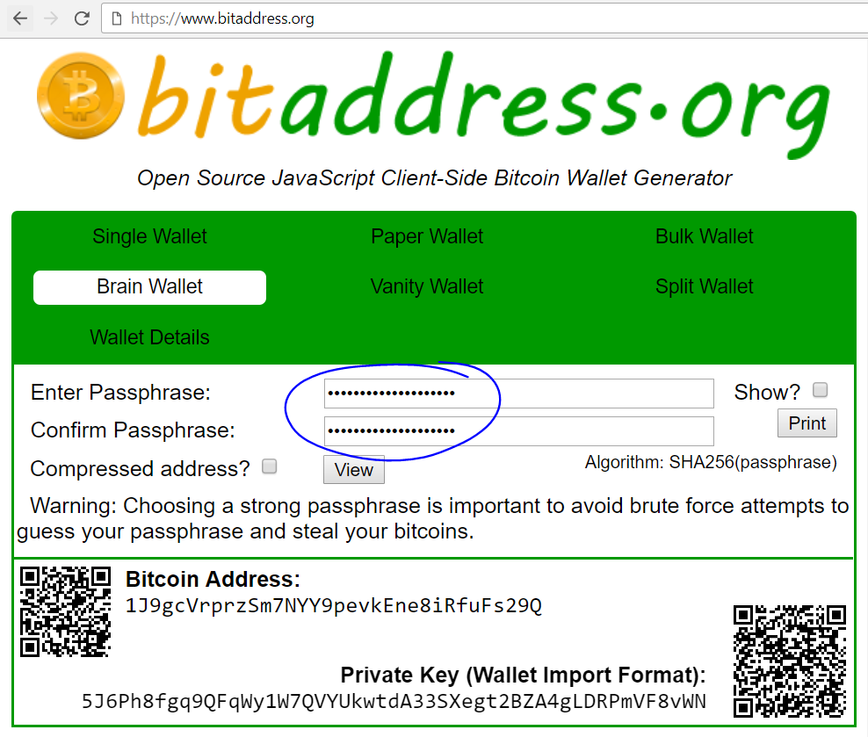
Brain Wallets
Brain wallets derive a private key from a passphrase
Just think out a long passphrase and remember it
E.g. use PBKDF2 or Argon2
Considered insecure
"Lost passphrase" and "too easy passphrase" vulnerabilities

Slide 12
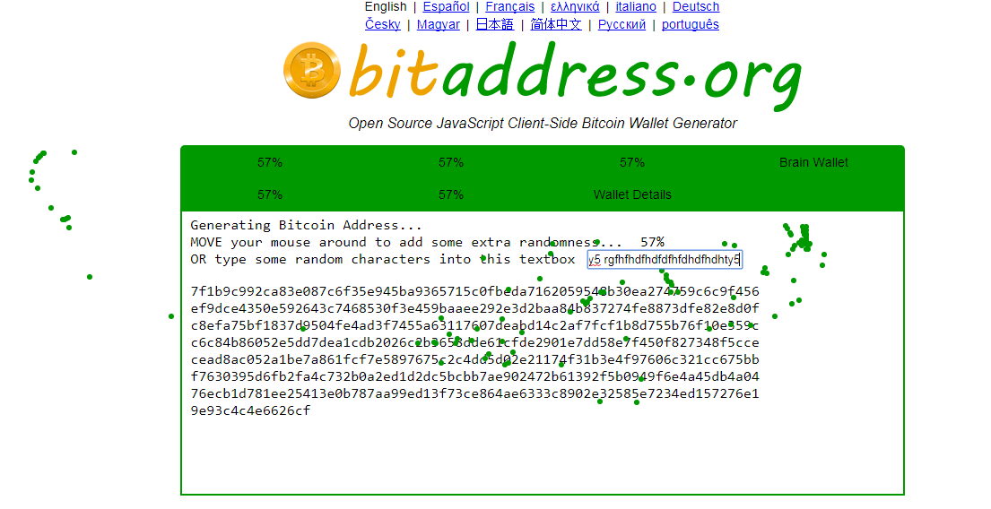
Generating Single Wallet and Paper Wallet

Slide 13
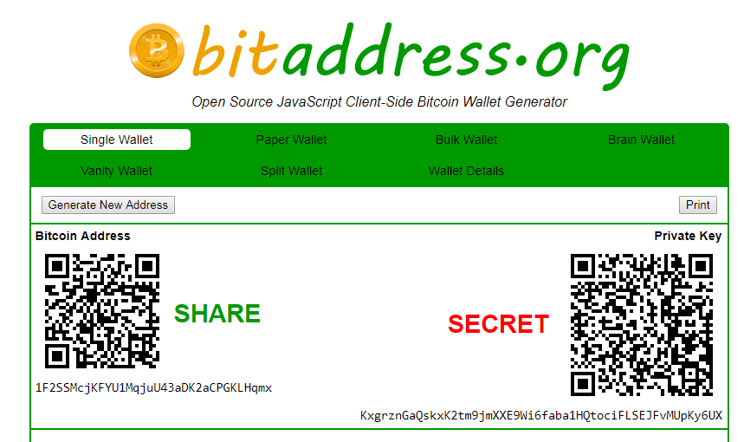
Generating a Single Wallet
Generates a random private key (entropy from keyboard & mouse)
Then derives a public key, then Bitcoin address (26-35 characters)
Notes:
A Bitcoin Address is an identifier of 26-35 characters showing a destination for a payment
A Private Key is a secret number that allows bitcoins to be spent Every Bitcoin wallet contains one or more private keys

Slide 14
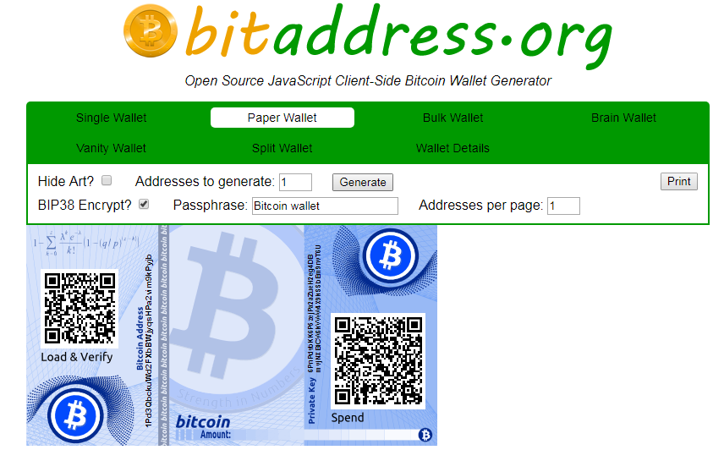
Generating a Paper Wallet
A paper wallet could be printed and kept safe
Sending a transaction from a paper wallet requires QR code scan
Notes:
After generated a paper wallet could be printed and kept safe
Sending a transaction from a paper wallet requires either scanning the QR code or manually entering the addresses

Slide 15
Mnemonic Seed in Crypto Wallets
Many crypto wallets start from a securely generated random seed
And build a hierarchical deterministic (HD) wallet (see BIP-32)
The seed (root key) can be represented as 12 or 24 words, e.g.
Each word comes from a wordlist of 2048 words → 1 word == 11 bits
24 words → 256-bit entropy → 512-bits seed (see BIP-39)
All private keys + addresses are later derived from the seed
See https://iancoleman.io/bip39 to understand the idea in practice
glad cup dance version wood apart jazz hard aunt ethics kick game

Slide 16
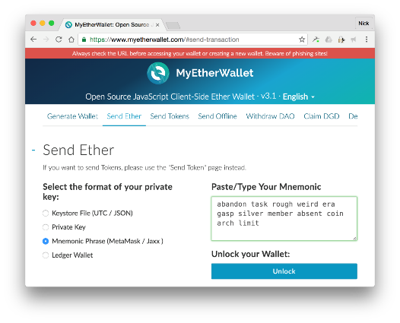
Crypto Wallet Software
Examples

Slide 17
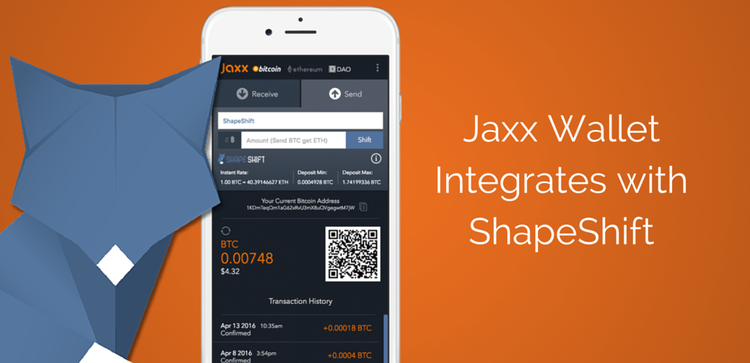
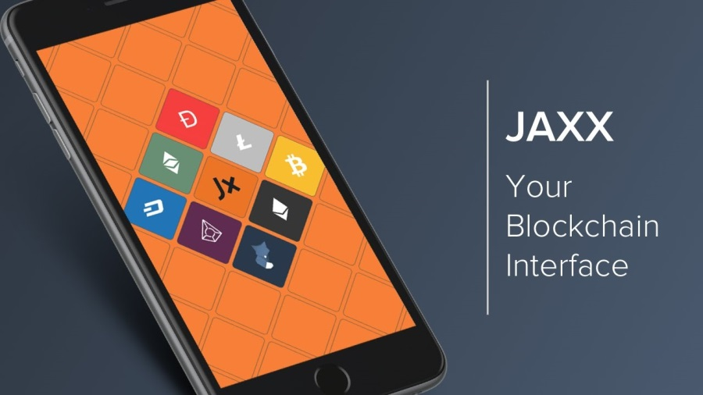
Mobile Wallet – Jaxx
Jaxx is a simple tool to hold and trade blockchain-based assets
Multi-coin support: Bitcoin, Ethereum, Litecoin, Dash, Zcash, …
Integrated with ShapeShift (a powerful crypto exchange)
True ownership of your private keys
Notes:
Jaxx is a simple tool to hold, control, and trade blockchain-based assets
Easy access to Jaxx wallet on any of the supported platforms
True ownership of your private keys

Slide 18
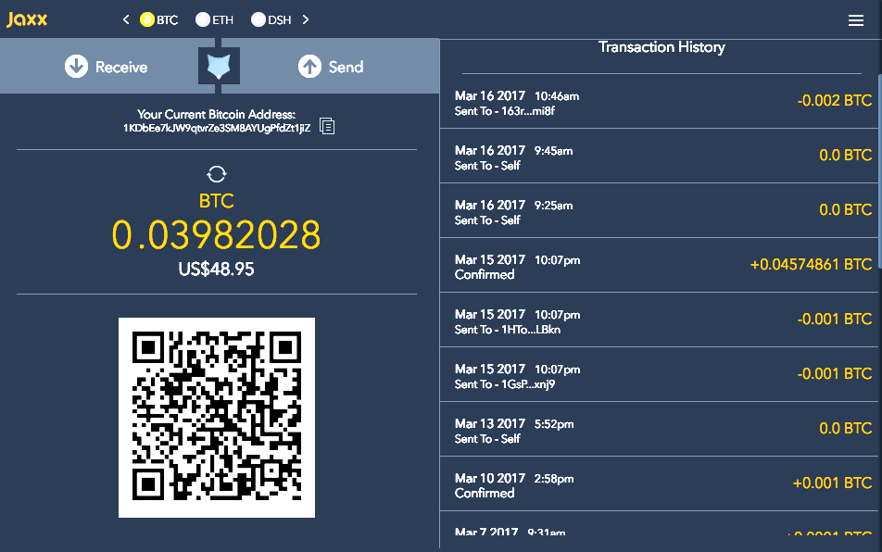
Jaxx Wallet – Pros
Open source
Mobile and desktop
Ideal for beginners
Wide crypto selection
Highly accessible

Slide 19
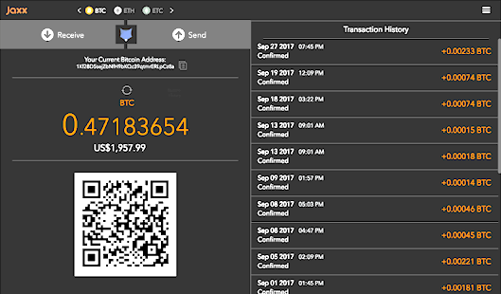
Jaxx Wallet – Cons
Security concerns
Lack of two-factor authentication (2FA)

Slide 20
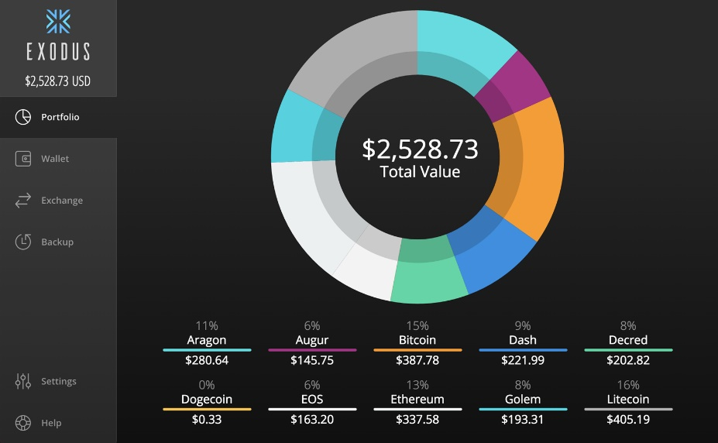

Desktop Wallet – Exodus
Exodus == desktop multi-asset wallet
Designed for people who have never used an cryptocurrencies
Hides the complex details behind the scenes
Inside the wallet cryptocurrencies can be traded via ShapeShift
Notes:
First desktop multi-asset wallet
Real time track the value of your portfolio
Designed for people who have never used an exchange
Exodus hides the complex details behind the scenes
Beautiful and intuitive design
Information is stored on your computer
Inside the wallet cryptocurrencies can be traded via ShapeShift

Slide 21

Trade via ShapeShift in Exodus
Cryptocurrencies can be traded in seconds with ShapeShift
Exodus hides the trading details internally

Slide 22
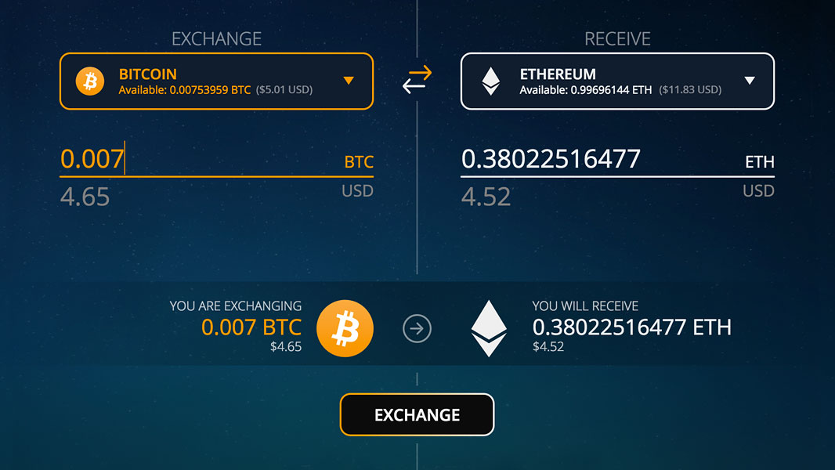
ShapeShift Example in Exodus

Slide 23
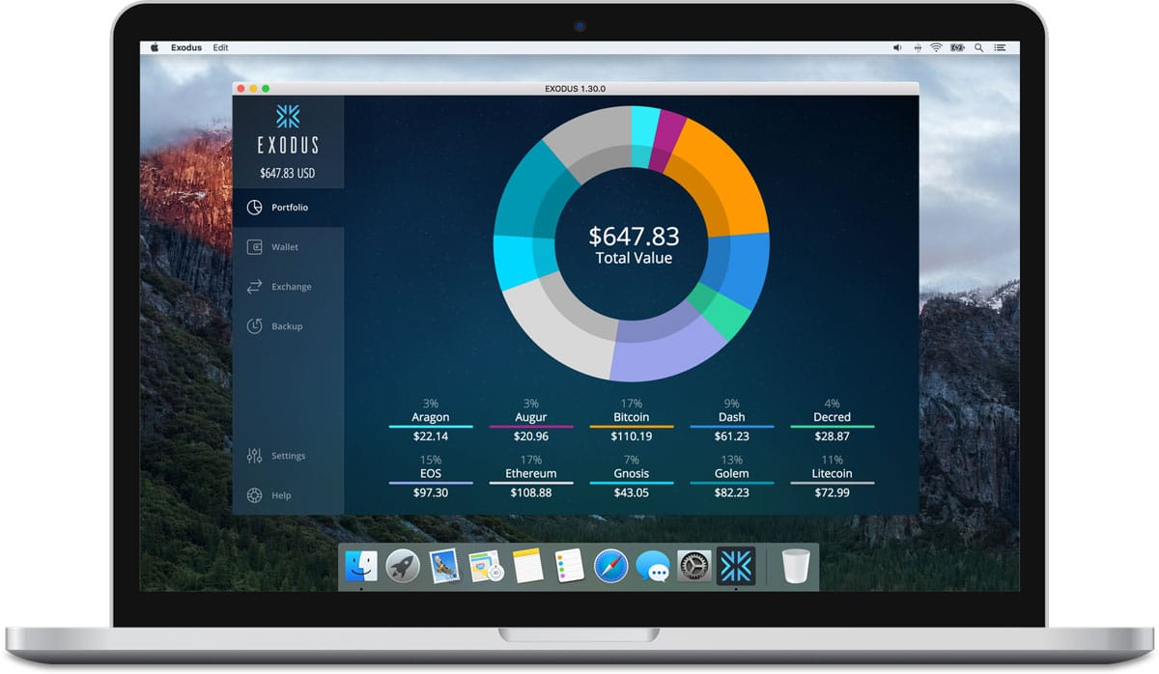
Exodus Wallet – Pros
Great design
Intuitive interface
Multiple support channels

Slide 24
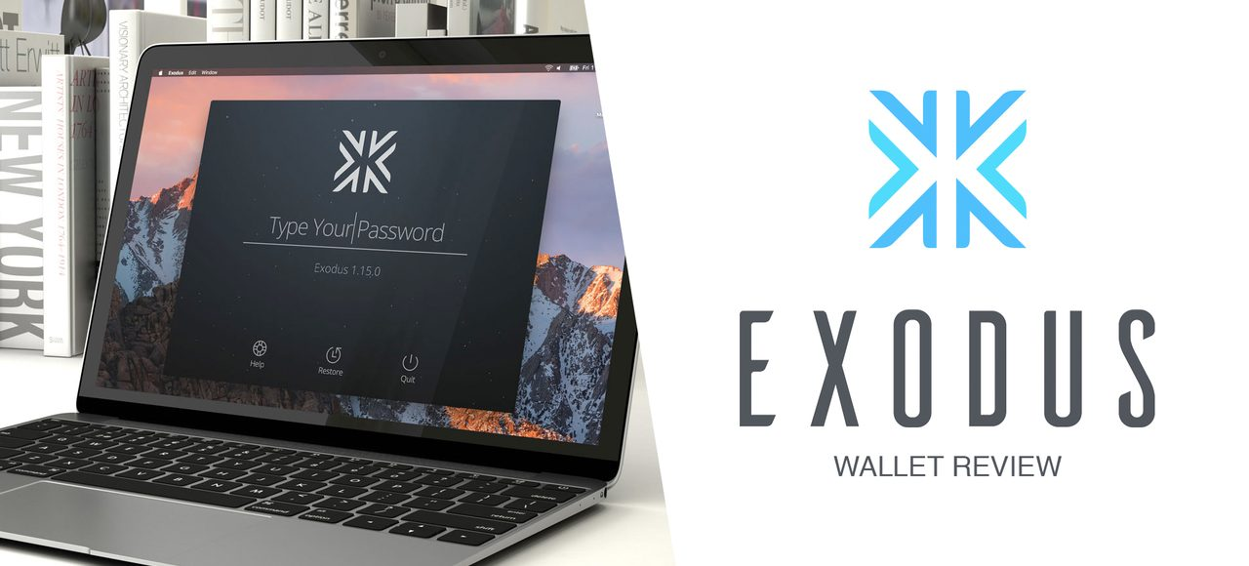
Exodus Wallet – Cons
No mobile version
Not open source

Slide 25
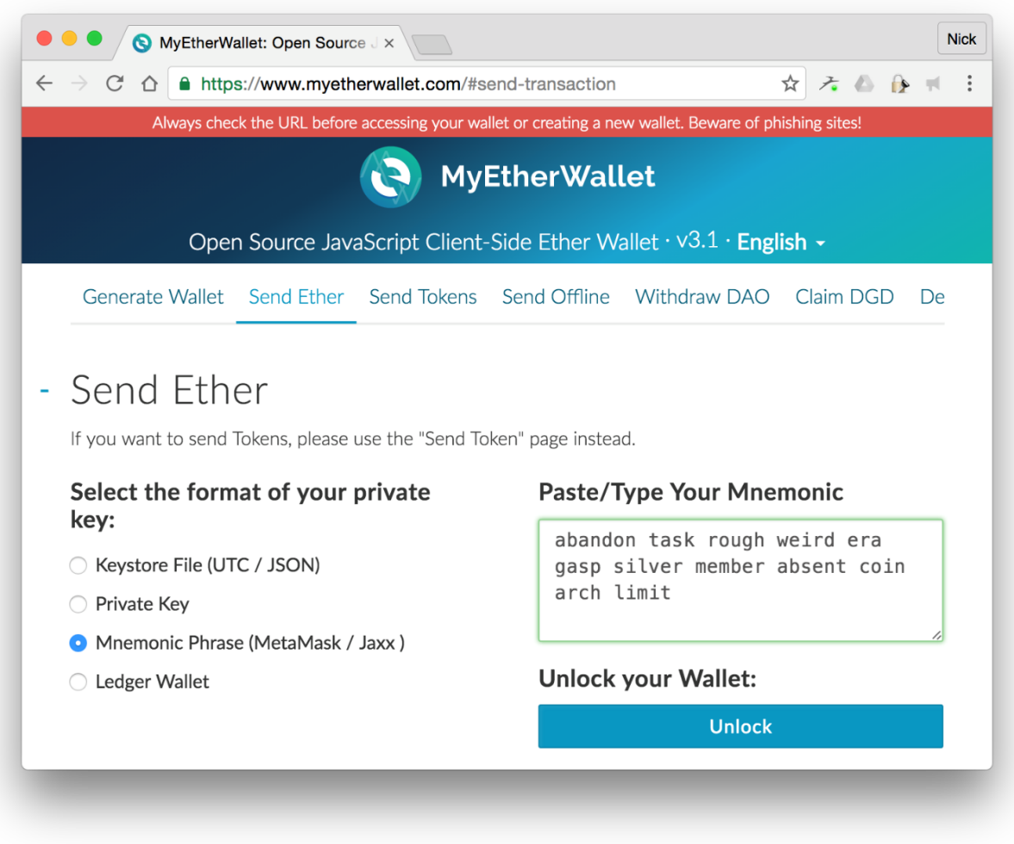
Online Wallets: MyEtherWallet
Online software wallets are similar to those at an exchange
Vulnerable if the exchange site is compromised in any way
Good option for beginners
MyEtherWallet is a client-side JavaScript-based Ethereum wallet
Secure: your keys are never sent to the server-side
Good for Ethereum developers

Slide 26
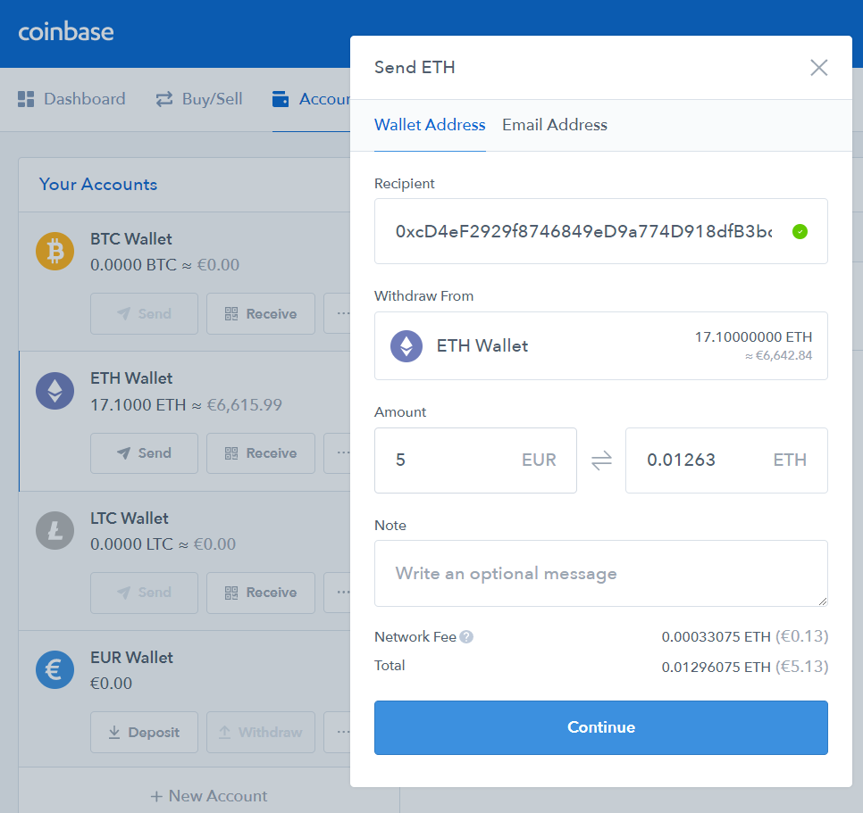
Online Wallets: Coinbase
Server-side online wallets
Keep your private keys
You can't access them
You can send transactions from their Web app
Example of online wallet:
coinbase.com
Online server-side wallet
Crypto-exchange service

Slide 27
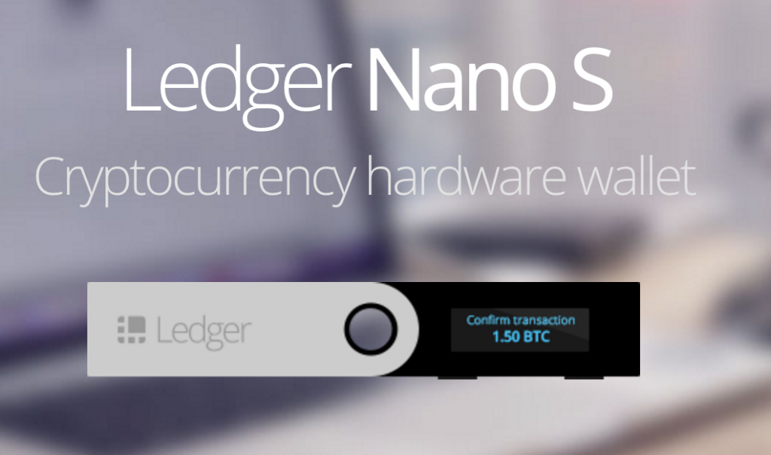
Hardware Wallets: Ledger Nano S
Ledger Nano S == crypto hardware-based wallet
Confidential data is never exposed (sign inside the wallet)
Secured inside an isolated environment locked by a PIN
Based on BIP-32
Hierarchical deterministic wallet (HD wallet)
All keys inside are dependent on the initial 24 seed words

Slide 28
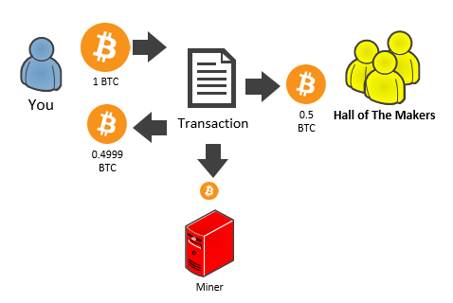
Blockchain Transactions
Transaction Structure, Signing, Sending

Slide 29
Transaction Models
Blockchain transaction models: UTXO vs. account balances
The UTXO model (used by Bitcoin, Litecoin, NEO, Cardano)
TODO
The account balances model (used by Ethereum, Stellar, NEM)
TODO

Slide 30
Bitcoin Transactions
Bitcoin transaction
А transfer of bitcoin value (inputs → outputs)
Broadcasted to the network and mined later into blocks
Holds a set of inputs (prev_tx + signature)
The sender address and value is taken from the prev_tx
Holds a set of outputs (address + value)
A transaction takes prev_tx outputs as new transaction inputs
Spends all input bitcoin values to the new outputs
Notes:
Bitcoin Transaction Inputs and Outputs
Any Bitcoin amount that we send is always sent to an address
Any Bitcoin amount we receive is locked to the receiving address which is associated with a wallet
Any time we spend Bitcoin the amount will always come from funds previously received and currently present in our wallet
Addresses receive Bitcoin but Bitcoin is sent from a wallet

Slide 31
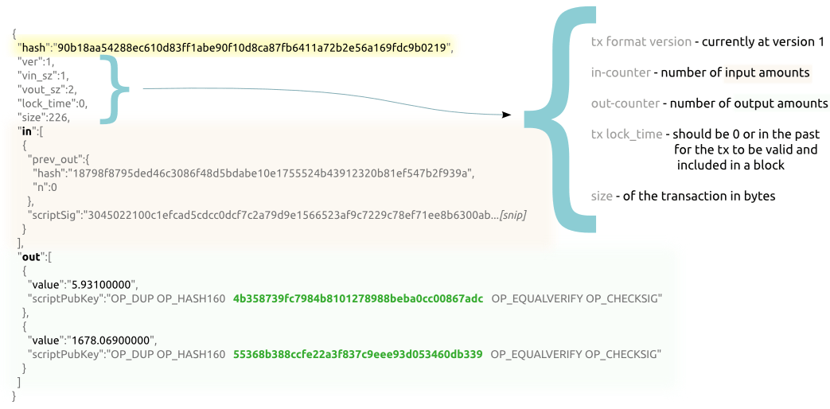
Creating a Bitcoin Transaction – Example
View details: https://blockchain.info/tx/90b18aa54288ec610d83ff1abe90f10d8ca87fb6411a72b2e56a169fdc9b0219
Notes:
Bitcoin Transaction Inputs and Outputs
Any Bitcoin amount that we send is always sent to an address
Any Bitcoin amount we receive is locked to the receiving address which is associated with a wallet
Any time we spend Bitcoin the amount will always come from funds previously received and currently present in our wallet
Addresses receive Bitcoin but Bitcoin is sent from a wallet

Slide 32
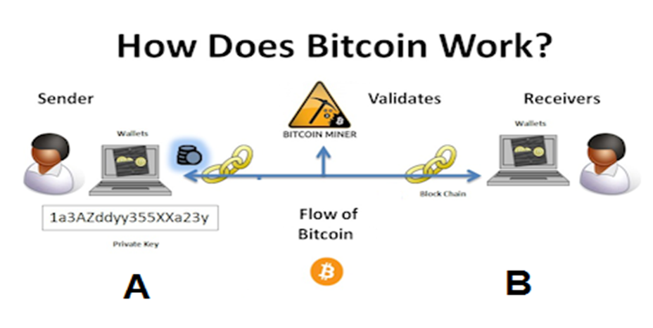
How a Bitcoin Transaction is Sent?
Things needed:
Sender private key
Receiver address
Value to be transferred
Things provided by the wallet software:
Input transaction hash (prev_tx)
Change address (new address in the sender's wallet)

Slide 33
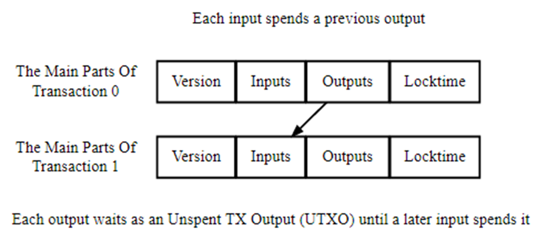
Transaction Chaining and UTXO
Each transaction input references an unspent output from a previous transaction (UTXO – Unspent TX Output)
Notes:
Each transaction has at least one input and one output
Each input spends the satoshis paid to a previous output
Each output then waits as an Unspent Transaction Output (UTXO)

Slide 34
Transaction Fees
What is a transaction fee?
Fee = {sum of all outputs} - {sum of all inputs} in a transaction
The fee is paid to miners who include that transaction in a block
Input address | Value
1EnimyBtFhnznMPVsAjtF… | 1.25
3QeQh2EhM16cv2Lf15Еz… | 0.25
1EER58rEaxnSE5TTrtiKr7i… | 0.50
Output address | Value
1A76Hhd7ahsHa5rFGat6… | 1.80
3Mgh5G8HhsOJs68pIgsB… | 0.15
Total outputs: 1.95
Total inputs: 2.00
Transaction fee = 2.00 - 1.95 = 0.05

Slide 35
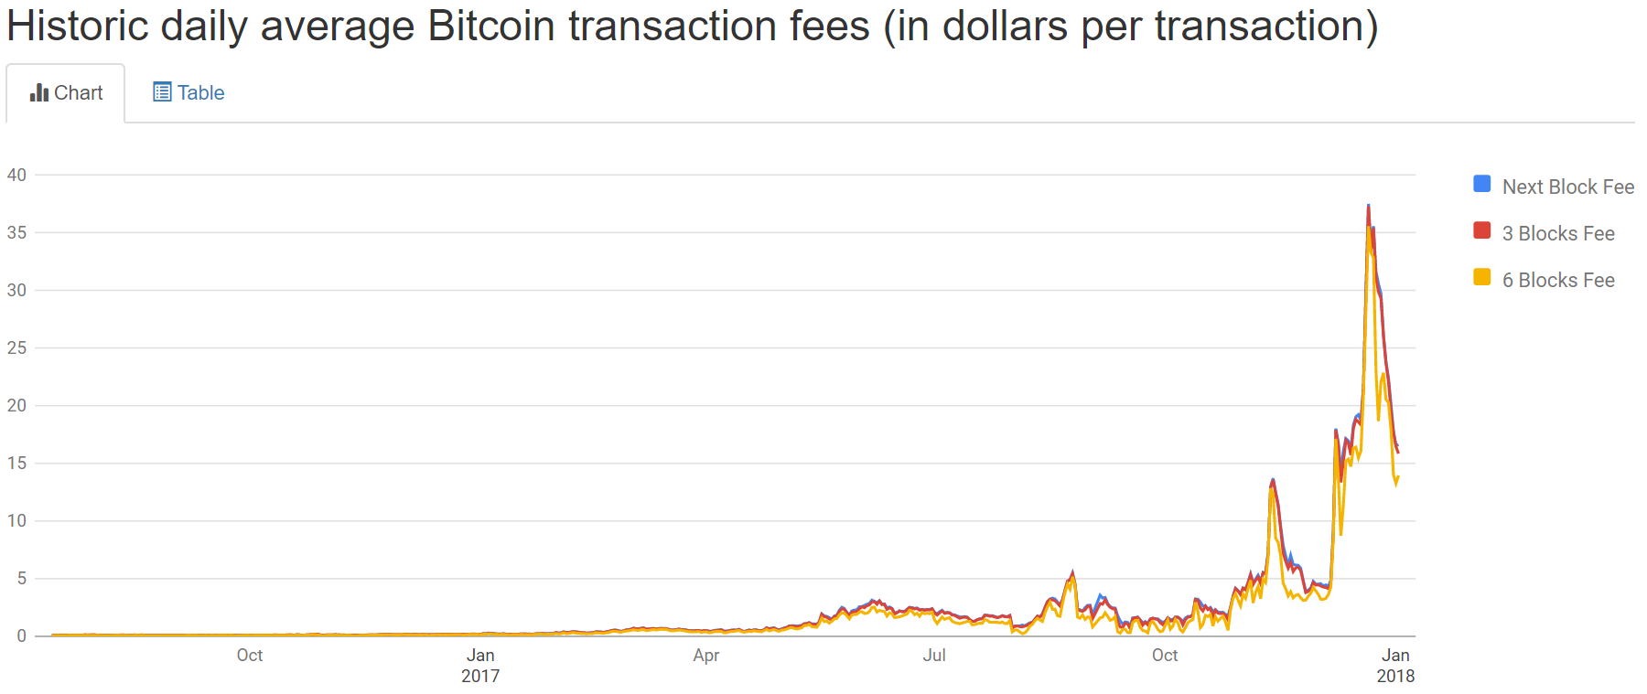
Transaction Fees per Byte
Miners include first the transactions with the highest fee per byte
Fees per byte are calculated based on current demand for space in the mined blocks with fees rising as demand increases
Learn more at:
bitcoinfees.info
bitcoinfees.earn.com

Slide 36
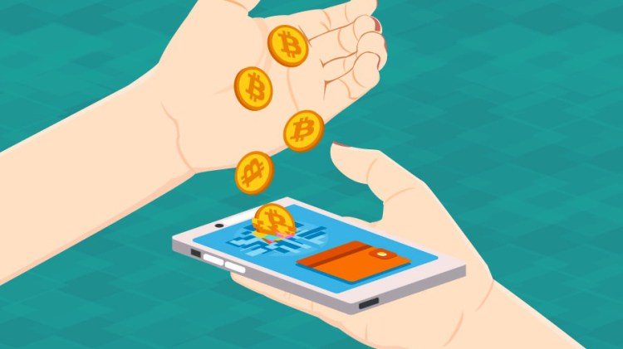
Exercises
Cryptocurrency Wallets and Transactions

Slide 37




Summary
Mobile wallets – Jaxx as example
Desktop wallets – Exodus as example
Web-based wallets
Hardware-based wallets
Paper wallets & mnemonic wallets
Cryptocurrency wallet products
Bitcoin transactions and fees

Slide 38
Cryptocurrency Wallets and Transactions
http://www.kingsland.academy

Slide 39
Resources
https://bitcoin.org
http://www.exodus.io/
Jaxx Wallet – https://jaxx.io
Bitcoin Address and Wallet Generator – https://www.bitaddress.org
https://en.bitcoin.it/wiki/Transaction

